Slide 1
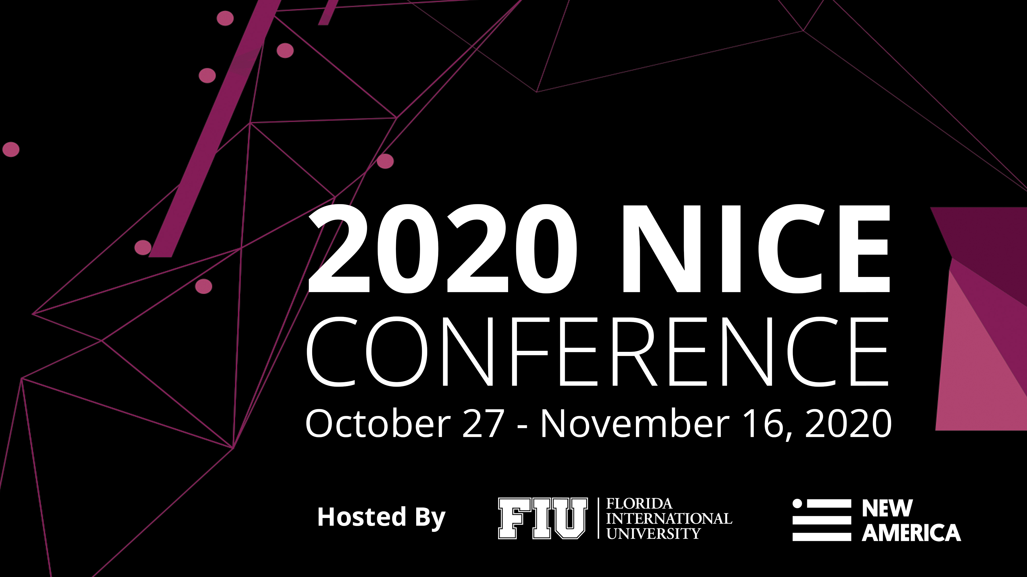

Slide 2
Randy Pestana
Director of Education and Training for Cybersecurity@FIU
Florida International University
Conference Emcee
Welcoming
Remarks

Slide 4
Mark B. Rosenberg
President
Florida International University
Conference
Welcome

Slide 5
Rodney Petersen
Director
National Initiative for Cybersecurity Education (NICE)
Opening
Remarks

Slide 6
Past Decade, Prior Strategic Plan
ACCELERATE LEARNING AND SKILLS DEVELOPMENT
NURTURE A DIVERSE LEARNING COMMUNITY
GUIDE CAREER DEVELOPMENT AND WORKFORCE PLANNING
Inspire a sense of urgency in both the public and private sectors to address the shortage of skilled cybersecurity workers
Strengthen education and training across the ecosystem to emphasize learning, measure outcomes, and diversify the cybersecurity workforce
Support employers to address market demands and enhance recruitment, hiring, development, and retention of cybersecurity talent

Slide 7
New Decade, New Vision
Prepare, grow, and sustain a cybersecurity workforce that safeguards and promotes America’s national security and economic prosperity.

Slide 8
New Decade, Similar Mission
To energize, promote, and coordinate a robust community working together to advance an integrated ecosystem of cybersecurity education, training, and workforce development

Slide 9
New Decade, Same Values
Foster communication
Facilitate collaboration
Share and leverage resources
Act based on evidence
Evaluate and improve
Challenge assumptions
Stimulate innovation
Model inclusion

Slide 10
New Decade, New Goals

Slide 11
NICE Framework
Align NICE Framework with Other Cybersecurity and Privacy Guidance
Process for Regular Reviews and Updates
Tools to Increase Access and Interoperability
Identify Cybersecurity Work Subject to Automation
International Adoption of NICE Framework

Slide 12
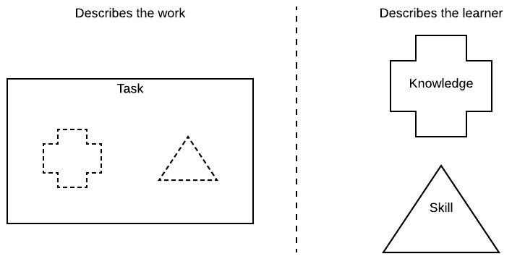
NICE Framework at the NICE Conference & Expo
October 27th Plenary Session: NICE Framework Across Sectors
October 29th Workshop: NICE Framework Adoption Strategies
November 16th Release of Revised NICE Framework
November 16th Release of Cybersecurity Skills Journal Special Edition

Slide 13
Transform Learning
Multidisciplinary Approaches and Cybersecurity Integration
Credentials that Validate Competencies
Performance-Based Assessments to Measure Competencies
Learning and Employment Records to Communicate Skills
Teachers, Faculty, and Instructors as In-Demand Workforce

Slide 14
Transform Learning at the NICE Conference & Expo
November 5th Plenary Session Panel: Transforming the Learning Ecosystem
November 5th Industry Session: Building a Cybersecurity Workforce in the Covid Era
November 6th Workshop: Curriculum Development in an Online Platform
Track Sessions: The Learning Ecosystem

Slide 15
Career Discovery
Career Discovery and Diverse Stakeholders
Multiple Pathways to Work Roles in NICE Framework
Assessment Tools to Identify and Recruit Talent
Resources and Tools for Those Who Guide Career Choices
Employer Support of Career Discovery and Work-Based Learning

Slide 16
Career Discovery at the NICE Conference & Expo
November 9th-14th National Cybersecurity Career Awareness Week (nist.gov/nice/nccaw)
November 9th Release of New CyberSeek Data
November 9th Fireside Chat with the 2020 Presidential Cybersecurity Education Award Recipients
November 9th Plenary Session Panel: Career Discovery
November 8th-14th National Apprenticeship Week (apprenticeship.gov/national-apprenticeship-week)
November 12th Workshop: Building Apprenticeships for the 21st Century
Track Sessions: Career Discovery

Slide 17
Talent Management
Automated Approaches to Connect Employers with Learners
Capability Indicators to Perform Tasks in the NICE Framework
Entry-Level Opportunities for Growth and Advancement
Ongoing Development and Training of Employees
Reskilling for Cybersecurity Careers

Slide 18
Talent Management at the NICE Conference & Expo
November 16th Plenary Session: Modernizing the Talent Management Process
November 17th Workshop: Diversify - The Cybersecurity Survival Guide
Track Sessions: The Talent Lifecycle

Slide 19
Research on Effective Practices
Factors that Influence Impact of Cybersecurity Education, Training, and Workforce Development
Trustworthy Advice Based on Data-Driven Evidence
Effective and Proven Practices for Blending Successful Learning Practices
Utilize Research Results to Inform Programs and Initiatives

Slide 20
Next Steps: Implementation Plans and Metrics
Implementation Plans for Goals
Goal
Ahead
Metrics
Identify existing programs and initiatives
Conduct ongoing environmental scan
Develop strategies to accomplish objectives
Identify gaps and prioritize efforts
Establish measures of success
Report on progress

Slide 22
Danielle Santos
Manager of Communications and Operations
NICE
Matt Isnor
Program Lead, Cyberspace Workforce Development
United States Department of Defense
Becky Staton
Information Security Executive
Bank of America
Steve Visintine
Senior IT Professional
Chevron
NICE Framework Across Sectors

Slide 23
Joanne Sexton
Director of the Cyber Institute
Augusta University
Email: JSEXTON1@augusta.edu
Diane Miller
Director of InfoSec Operations and Identity Management Northrop Grumman
Email: jepstein@nsf.gov
Jeremy Epstein
Program Director
National Science Foundation
Email: diane.miller@ngc.com
Conference
Overview

Slide 24
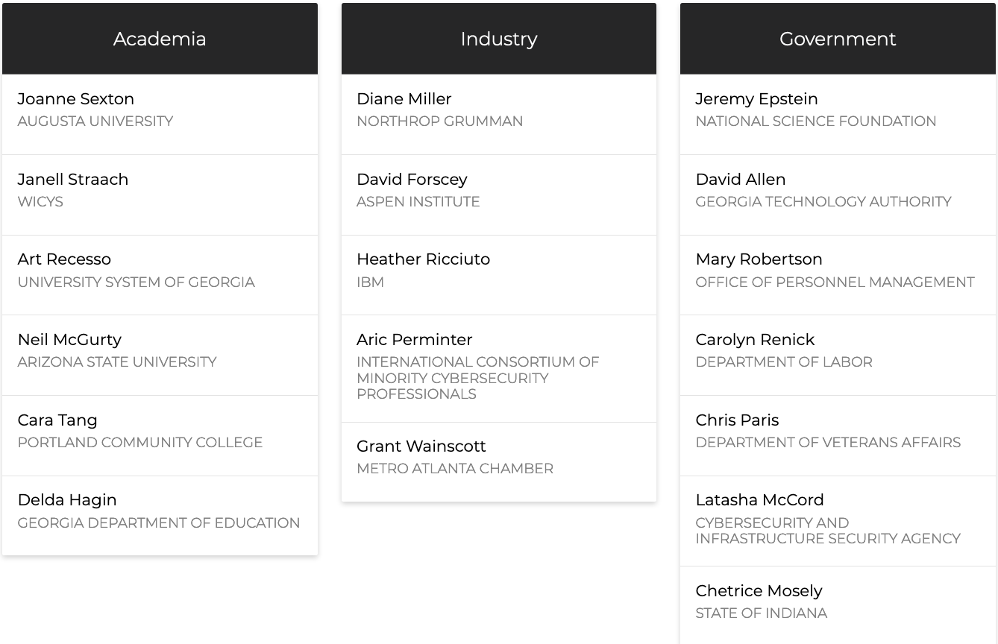
Program
Committee
Jodi Guss

Slide 25
Exhibit Hall
Break
3 p.m. – 3:30 p.m.
4:15 p.m. – 4:30 p.m.

Slide 26
3:30 p.m. – 4:15 p.m.
4:30 p.m. – 5:15 p.m.
Career Discovery
The Talent Lifecycle
The Learning Ecosystem
Effective Leadership
Breakout
Sessions

