Slide 1
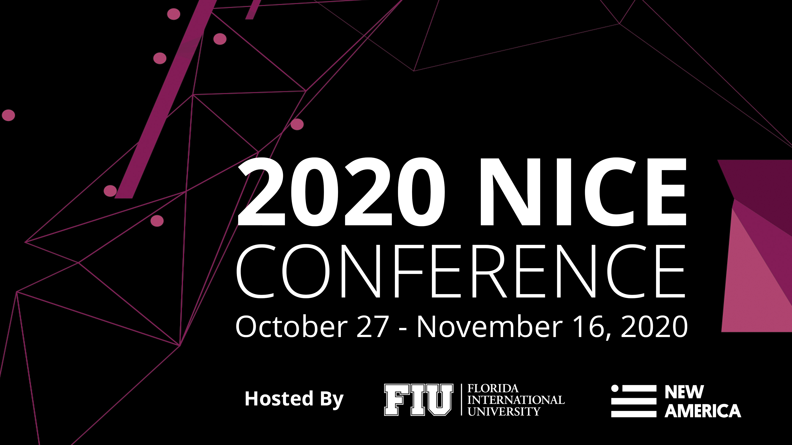

Slide 2
Randy Pestana
Director of Education and Training for Cybersecurity@FIU
Florida International University
Conference Emcee
Welcoming
Remarks

Slide 4
Robert Grillo
Vice President and CIO
Florida International University
Conference
Welcome

Slide 5
NICE Working Group Updates
Jose-Marie Griffiths
President
Dakota State University
Jon Brickey
Senior Vice President, Cybersecurity Evangelist
Mastercard

Slide 6
Purpose
Established in 2014, the NICE Working Group provides a mechanism in which public and private sector participants can develop concepts, design strategies, and pursue actions that advance cybersecurity education, training, and workforce development.
Notes:
NICE Working Group had Monthly Meetings (except August and November). The structure of the Working Group consisted of six subgroups (next slide)

Slide 7
NICE Working Group Subgroups
APPRENTICESHIPS
COLLEGIATE
COMPETITIONS
WORKFORCE MANAGEMENT
K12
TRAINING & CERTIFICATIONS
Notes:
There are 6 subgroups within the Working Group, each focused on a specific topic (Apprenticeships, Competitions, etc.). Each subgroup further has one or more project teams which are geared toward a specific projects and deliverables.

Slide 8
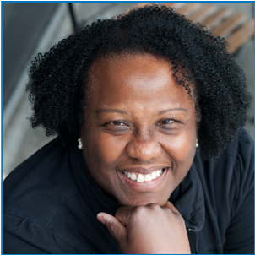
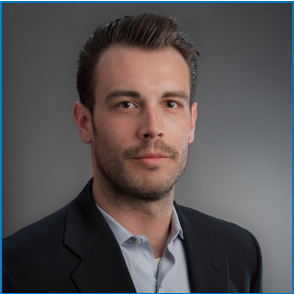
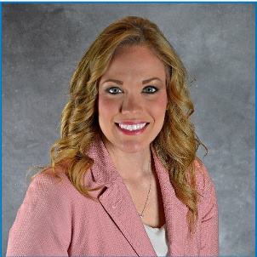
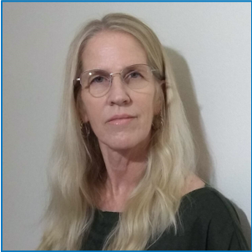
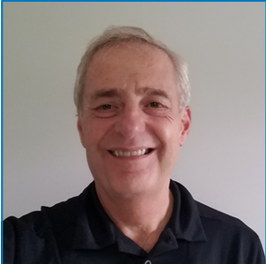
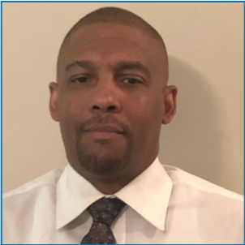
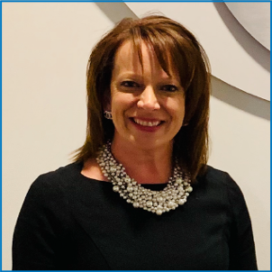
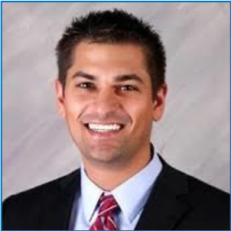
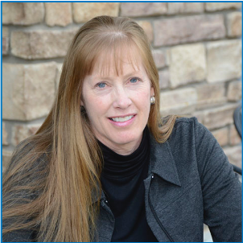
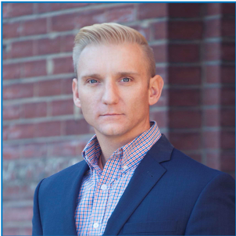
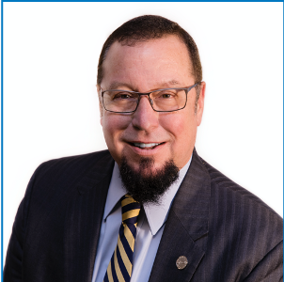
Subgroup Co-Chairs
Notes:
Over the past year, these subgroups have been led by volunteers in the NICE community who have driven the groups to complete “products” such as one pagers and other resources. The working group wouldn’t not be successful without their leadership. Here are a few examples of the projects that have been completed this year (next slide)

Slide 9
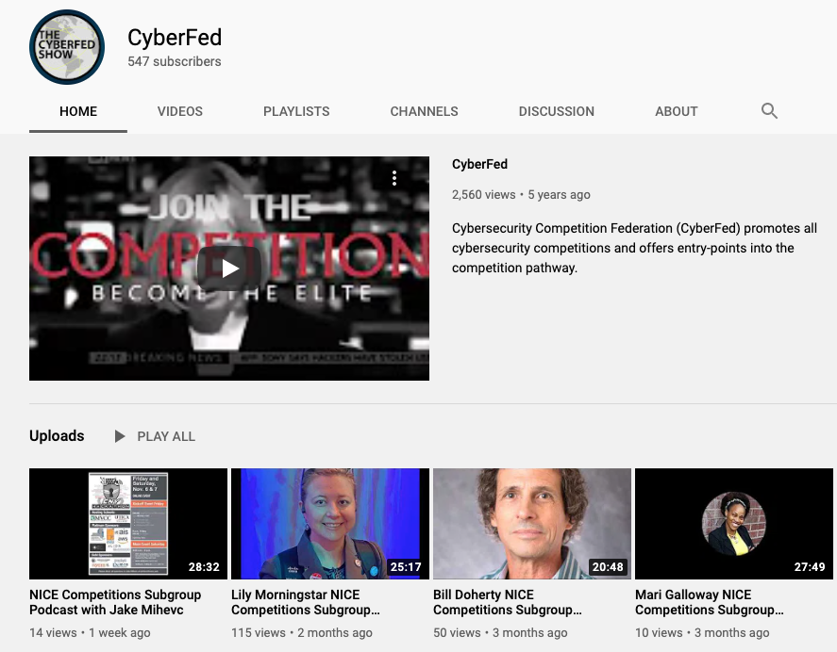
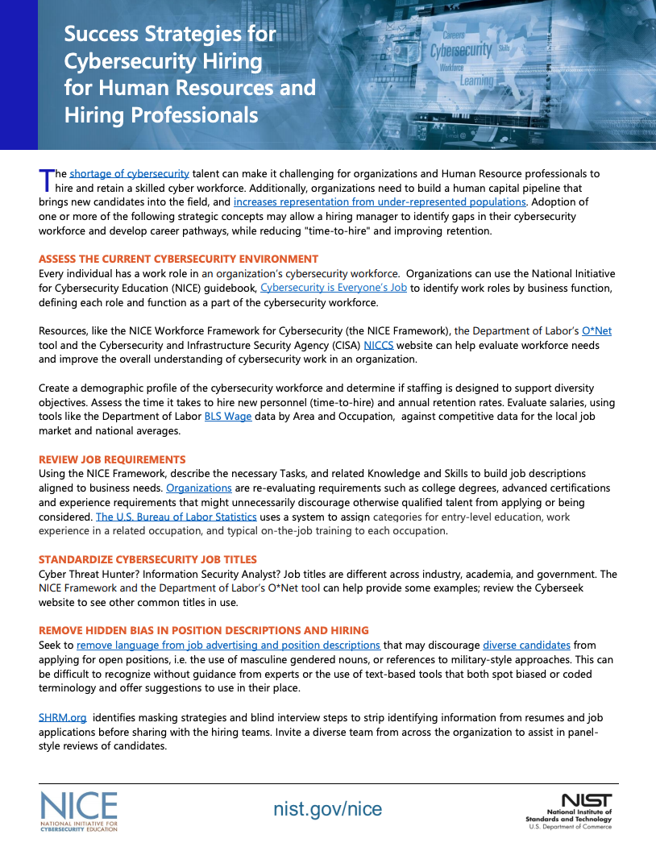
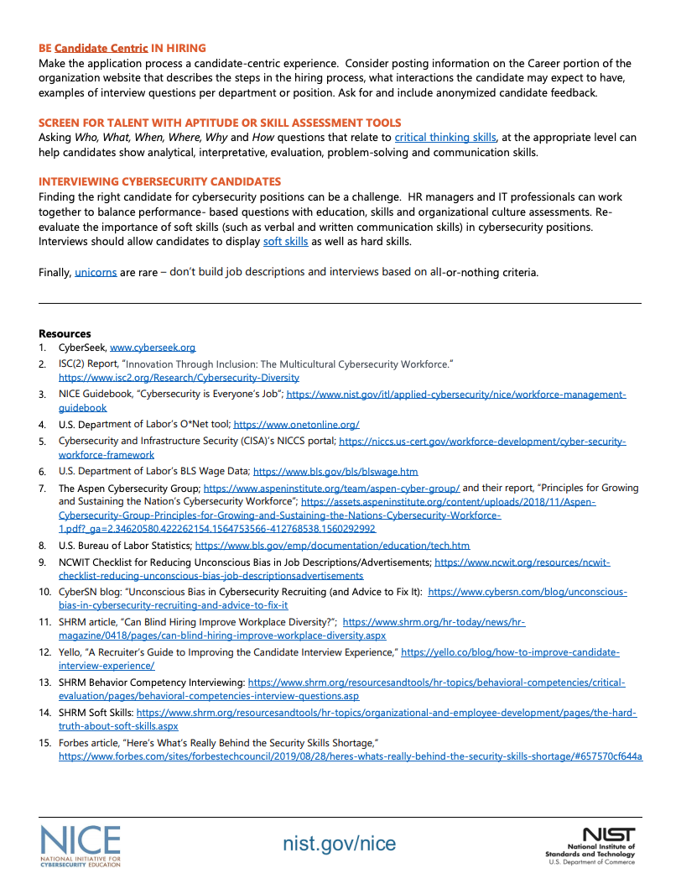
Subgroup Accomplishments
Continuation of Competition Podcasts on the YouTube CyberFed channel
Human Resources one pager: Successful Strategies for Cybersecurity Hiring
Notes:
In the past year alone, the Competitions subgroup has developed over 10 new competitions podcast episodes for the CyberFed youtube channel.
The Workforce Management subgroup has developed a one pager on “Successful Strategies for Cybersecurity Hiring”

Slide 10
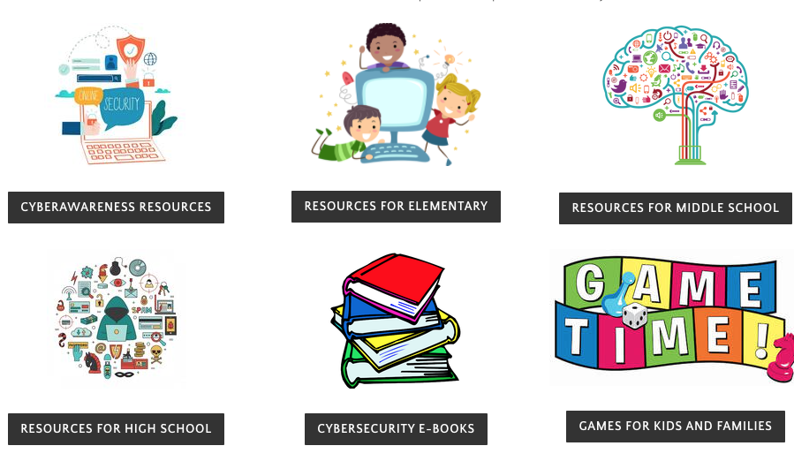
Subgroup Accomplishments
Development of the K12 Cybersecurity Career Awareness for School Counselors and Administrators one pager
Curation of known K12 educational resources for at-home use
Development of Career and Technical Education Report outline
Notes:
The K12 subgroup has also been very active this year. Some of their completed projects include: the K12 Cybersecurity Career Awareness for School Counselors and Administrators one pager, the Career and Technical Education Report outline, and curating a repository of k12 educational resources for at-home use.
Jon Brickey is up next to discuss some changes and improvements to the NICE Working Group.

Slide 11
Introducing the NICE Community Coordinating Council
The “NICE Community”
Monthly Meetings that bring together Public and Private Sector Groups and Programs
Conference Program Committees
NICE Conference & Expo
NICE K12 Cybersecurity Education Conference
Federal Information Security Educators (FISSEA) Conference
Federal Cybersecurity Workforce Summit
NICE Community Coordinating Council
Communities of Interest
Working Groups
Project Teams
NICE Community Coordinating Council (formerly NICE Working Group)
Co-Chairs: Academia, Industry, and Government
Notes:
We are modifying the NICE community group structure to increase impact and in our ongoing efforts to continuously improve.
The new structure increases alignment to the new NICE Strategic Plan and ensures that we are resourced to maximize progress.
The Community includes conference program committees and the NICE Working Group, which becomes the NICE Community Coordinating Council. The new name reflects the role to communicate and coordinate across the public and private sectors
The groups that make up the Community Coordinating Council include:
Communities of Interest (formerly NICE Working Group Subgroups)
Working Groups (aligned to NICE Strategic Plan)
Project Teams (Cross-Functional Teams focused on Grand Challenges)
We are renaming some of the groups to better reflect their intended purposes

Slide 12
NICE Community Coordinating Council Communities of Interest
Stakeholders and Constituencies
K12 Cybersecurity Educators
Cybersecurity Skills Competitions
Apprenticeships in Cybersecurity
NICE Framework Users Group
Add your Community of Interest Here
Purpose and Operations
Networking and collaboration
Email list and collaboration space
Virtual and in-person convenings, as necessary, throughout the year
Notes:
The NICE Subgroups become NICE Communities of Interest as these groups provide collaboration opportunities that focus on specific constituency needs and develop corresponding products and services.
Some of these groups may look familiar as they focus on current subgroup topics such as K12, Competitions, and Apprenticeships.
These groups are led by community members, but are primarily email lists and forums for sharing information and posing questions.

Slide 13
NICE Community Coordinating Council Working Groups, coming January 2021
Aligned to new NICE Strategic Plan Goals and Objectives
Promote Career Discovery
To include National Cybersecurity Career Awareness Week
Transform Learning Process
To include constituents from K12, Collegiate, Training & Certifications, and more!
Modernize Talent Management
To include constituents from Workforce Management and more!
Notes:
We are introducing NICE Working Groups to actively implement, measure, and execute upon the NICE Strategic Plan goals and objectives
These groups will have a 5-year duration, aligned to the new NICE Strategic Plan.
Some current subgroup topics like Collegiate, Training and Certifications, and Workforce Management will align to these new groups.
Although these 3 groups are aligned to specific goals in the strategic plan, they are also integrated with cross-cutting goals to “Expand Use of the NICE Framework” and “Drive Research on Effective Practices”

Slide 14
NICE Community Coordinating Council Project Teams, coming March 2021
Purpose: pursue innovations and devise solutions for emerging challenges and opportunities
“Grand Challenge” determined Annually or Semi-Annually through a Consultative Process Concrete Products or Deliverables at Least Annually
Notes:
We are also introducing NICE Grand Challenges Project Teams to bring together thought leaders to pursue innovations and devise solutions for emerging challenges and opportunities
These groups will have a duration of 6-12 months.

Slide 15
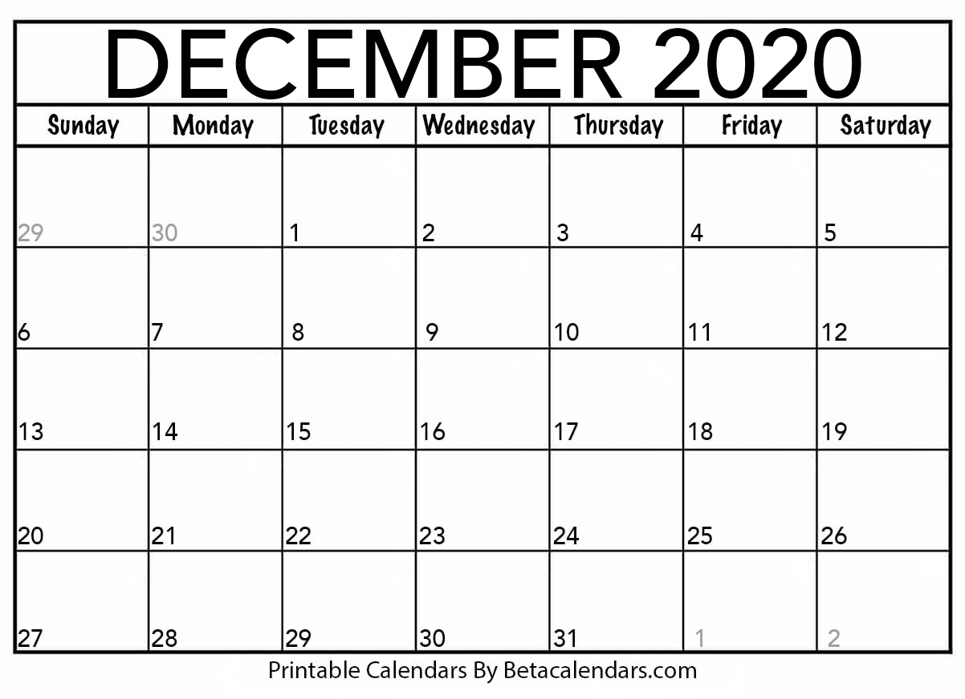
Kick-Off of NICE Community Coordinating Council
Wednesday, December 2nd, 3:30-5 pm ET
Notes:
Our next meeting will be on Dec 2nd. For those that are already members of the NICE Working Group, you will already have this meeting on your calendar. There is no action existing members need to take at this time to join the meeting.
I look forward to seeing you all at the Dec 2 meeting. I’ll now hand it back over to Dr. Griffiths for closing remarks.

Slide 16
Welcome, Marni
Marni Baker Stein
Provost and Chief Academic Officer,
Western Governors University
Incoming Academic Co-Chair,
NICE Community Coordinating Council
Notes:
<Insert commentary on academic perspective>
Introducing the incoming Academic Co-chair, Marni Baker Stein from Wester Governors University.

Slide 17
nist.gov/nice/nicewg
Notes:
The NICE Working Group would not be made possible without the the many volunteers from industry, academia, and government who contribute to the work and group discussions. You can view the various one-pagers, white papers, and other documents resources today as well as learn how to sign up to participate in the NICE Community Council at nist.gov/nice/nicewg.

Slide 18
Chauncy Lennon
Vice President for Learning and Work
Lumina Foundation
Matt Lisle
Director of Digital Learning Technologies
Georgia Tech
Olivia Herriford
Regional Director of Employer Engagement
Bay Area Community College
Tim Mason
Cyber Experienced Academic Entrepreneur and
Researcher
Transforming the Learning Ecosystem

Slide 19
Building a Cybersecurity Workforce in the COVID Era
Roy Zur
Founder and CEO
Cybint Solutions

Slide 20
Exhibit Hall
Break
2:45 p.m. – 3:15 p.m.
4:00 p.m. – 4:15 p.m.

Slide 21
3:15 p.m. – 4:00 p.m.
4:15 p.m. – 5:00 p.m.
Career Discovery
The Talent Lifecycle
The Learning Ecosystem
Effective Leadership
Breakout
Sessions

Slide 22
Evening Networking Event
5 p.m. – 6 p.m.
Demystifying the Cybersecurity Workforce
Heather Ricciuto
Academic Outreach Leader
IBM Security
Christopher Paris
Sr. Advisor Cyber Workforce Management
U.S. Department of Veteran Affairs
Chetrice L. Mosley-Romero
Cybersecurity Program Director Indiana Office of Technology
Indiana Department of Homeland Security

