Slide 2
Randy Pestana
Director of Education and Training for Cybersecurity@FIU
Florida International University
Conference Emcee
Welcoming
Remarks

Slide 3
Join Us In Celebrating
#mycyberjob Social Media Challenge
Contest and Competitions for all ages
25+ Webinars
42+ Training Opportunities
nist.gov/nccaw

Slide 5
Kick-Off of National Cybersecurity Career Awareness Week and National Apprenticeship Week
John Ladd
Administrator, Office of Apprenticeship, Employment and Training Administration
Department of Labor Office of Apprenticeships

Slide 6
Fireside Chat with the 2020 Presidential Cybersecurity Education Award Recipients
Kara Bear
Superintendent
Eagle Butte Public School District 20-1
Donna Woods
High school, dual-enrollment ICT/Cybersecurity Educator
Canyon Springs High School
Jean Morrow
Policy Advisor
United States Department of Education

Slide 7
Background on Presidential Cybersecurity Education Award
President Trump’s Executive Order on America’s Cybersecurity Workforce – May 2, 2019
Directive for U.S. Department of Education to create a new Presidential Cybersecurity Education Award
Department announced call for nominations during National Cybersecurity Awareness Month in October 2019; Winners announced near Teacher Appreciation Week in May 2019
Today, you’ll get to learn more about the inaugural awardees and the great work they have done in the field of cybersecurity education!

Slide 8
Inaugural Awardees

Slide 9
To learn more about the Presidential Cybersecurity Education Award
Visit https://www.ed.gov/stem
Announcement for call for 2020 – 2021 nominations – happening soon!
More details about the Inaugural Awardees, go here https://www.ed.gov/news/press-releases/us-secretary-education-betsy-devos-honors-two-educators-inaugural-presidential-cybersecurity-education-award
Thank you for joining this fireside chat!

Slide 10
Cyber Range + Remote Learning + NICE framework: Building a World-Class Workforce Development Program
Ed Adams
CEO
Security Innovations

Slide 11
About Ed Adams
CEO, Security Innovation Inc.
Host of Ed TALKS: www.edtalks.io
Director, ICMCP
Research Fellow, Ponemon Institute
Privacy by Design Ambassador, Canada
Mechanical Engineer, Software Engineer
In younger days, built non-lethal weapons systems for government & law enforcement
www.edtalks.io

Slide 12
About Security Innovation
Securing software in challenging places….
Helping clients get smarter about software security
Assessment: show me the gaps
Standards: set goals and make it easy
Training: enable me to make good decisions
Over
3 Million
Users
Authored
18
Books
Named
6x
Gartner MQ

Slide 13
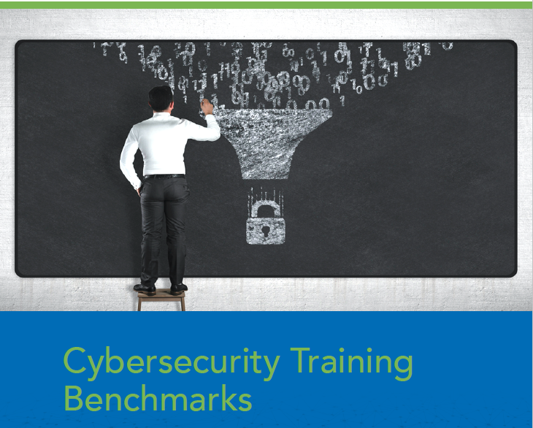
Recent Research from The Ponemon Institute
Assessed programs on 17 key elements
Measures Security Effectiveness Score (SES)
High SES Score Correlates to Less Mean Time to Find & Fix and Data Breaches
Some training practices proven more effective than others
https://web.securityinnovation.com/ponemon-cybersecurity-training-benchmarks
Notes:
SAS Score
A well-defined performance measurement tool that has been validated in more than 50 independent studies conducted since its creation
Able to capture all the elements that lead to a strong security posture
Scored on a scale from 1 (worst possible security posture) to 10 (best possible security posture)
The more cybersecurity training practices adopted, the higher the SES score. As shown in Figure 7, organizations that have adopted an average of 54 percent of the training practices are in the highest SES quartile.

Slide 14
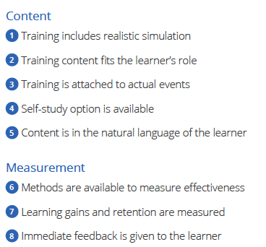
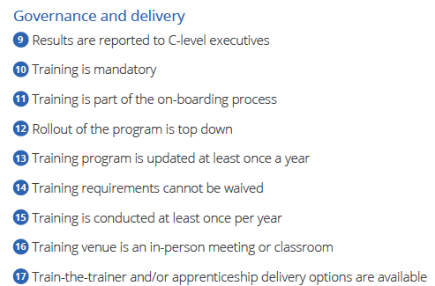
17 Elements (aka “best practices)

Slide 15
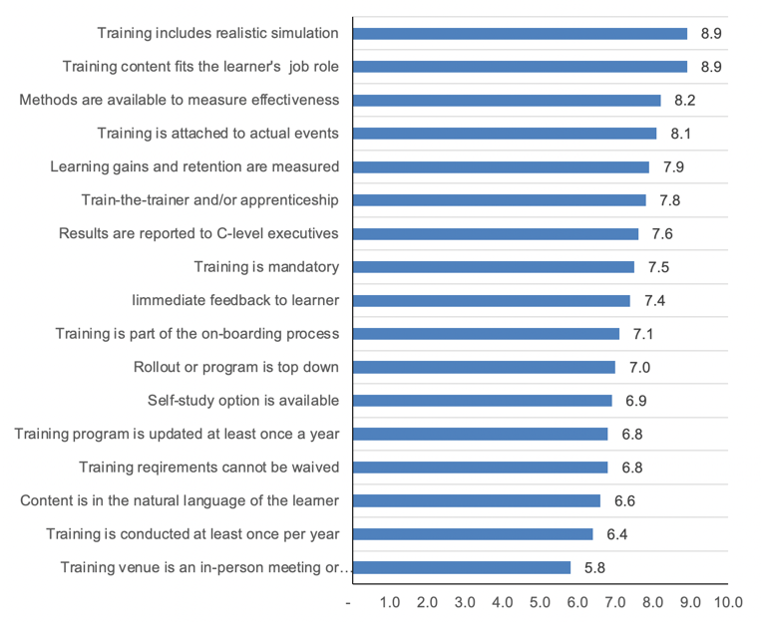
Training Benchmarks - What’s Most Effective
1 = low effectiveness
10 = high effectiveness
Realistic Simulation and Training Tied to Job Role are most effective
Notes:
Realistic simulation and training content that is relevant for the learner are the most effective training practices. Figure 8 presents the effectiveness of the 17 training benchmarks on a scale from 1 = low effectiveness to 10 = high effectiveness. Other effective training practices are having methods to measure effectiveness, training is attached to actual events and learning gains and retention are measured.

Slide 16
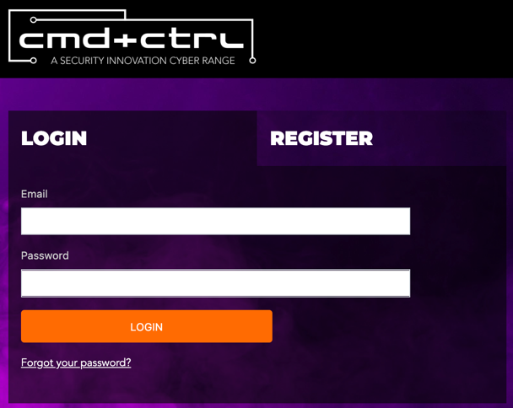
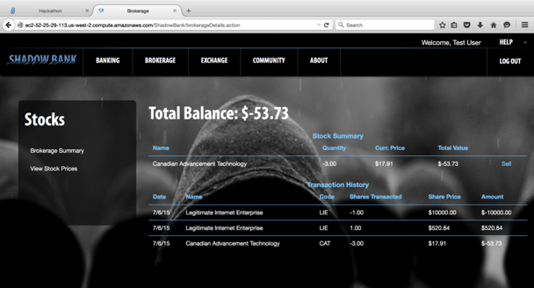
Cyber Ranges – old and new
VS.
Heavy hardware requirements
Network and infrastructure focus
Massive configuration
Gamified environment
Light weight – no hardware/software to install
Focus on modern tech stack environment (application, database, system, mobile, cloud)
Instant access and minutes to set up
Real-world simulated environment

Slide 17
Cyber Range Value
Real-time Assessment
Automated reports measure team and individual competency – not “grade” their memorization skills, but rather how they actually performed in practice.
Talent Identification
Hidden talents wait to be found! Hands on engagements help highlight those talents in ways traditional methods don’t.
Skill Shortage Intelligence
Identification of team member skills in a discrete and constructive way allows for quicker focus on additional training and education.
Tailored Training Plan
The resulting insight provides data necessary to streamline supplementary training and ensure users only take courses they need.

Slide 18
Remote Learning
2020 is the year of remote everything
Some tips to make remote learning work*
Hands-on Participation
Keep Lessons Modular
Interactive (“Learn by Doing”)
Focus on Content, not Comprehension
Teach New Concepts with Examples (“Show it!”)
Synchronous & Asynchronous
Guided lessons and self-paced exercises/labs/practice
*https://www.forbes.com/sites/nataliewexler/2020/04/08/7-tips-to-help-make-remote-learning-more-effective

Slide 19
Blended Training Reaches Different Learners
To what level do you agree the combination of hands-on Cyber Range experience with Computer Based Training will maximize the knowledge adoption?
Nearly 2/3 respondents ”significantly agree” the combination of Cyber Range with CBT will maximize the knowledge adoption
- 98% agree or significantly agree

Slide 20
NICE Cybersecurity Workforce Framework
Categories: A high-level grouping of common cybersecurity functions
Specialty Areas: Areas of concentrated work within cybersecurity
Work Roles: Detailed grouping of cybersecurity jobs
Common attributes sought
Tasks performed
Knowledge, skills, and abilities (KSAs) needed
For some, there are also Capability Indicators
Education, Certification(s), Continuous & Experiential Learning
Entry Level, Intermediate, Advanced
https://niccs.cisa.gov/workforce-development/cyber-security-workforce-framework/workroles
Many non-technical work roles suitable for diverse backgrounds.

Slide 21
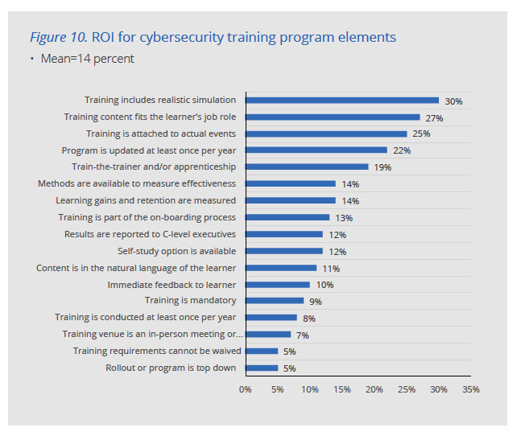
Realistic Simulation Yields 2X ROI vs. Average Element
"Regardless of spend or program size, realistic simulation and job-specific training are the most effective way to build lasting skills, raise security effectiveness scores (SES) and yield higher ROI.”
- Dr. Larry Ponemon

Slide 22
The easiest puzzle we’ll ever do! 3 highly complementary pieces
Remote Learning
NICE Framework
Cyber Range
Cyber Range: Training with Realistic Simulation
Learn by Doing, not Memorization
NICE Framework: Map Training Content to Learner’s Job
KSAs and Work Roles Provide Blueprint
Remote Learning: Must Do These Days
Blended Learning Most Effective
Keep It Interactive

Slide 23
Many Great Training Resources Available
NIST National Initiative for Cybersecurity Education (NICE)
https://niccs.us-cert.gov/training
https://www.nist.gov/itl/applied-cybersecurity/nice/resources/nice-cybersecurity-workforce-framework
US FTC
https://www.ftc.gov/tips-advice/business-center/small-businesses/cybersecurity
PCI SSC
https://www.pcisecuritystandards.org/program_training_and_qualification/webinars
https://www.pcisecuritystandards.org/program_training_and_qualification/
OWASP Academy:
https://owasp-academy.teachable.com/
Security Innovation CBT and Cyber Range:
https://www.securityinnovation.com/course-category/standard/nice/
https://www.securityinnovation.com/training/
https://community.securityinnovation.com/
https://web.securityinnovation.com/csnp-2020

Slide 24
Train 100,000 Techies in 1 Year?!?!
Sought to train 80,000 dev team members
Staff in 12 different countries
Over 50 job functions
Varying maturity levels
Aggressive but thoughtful plan:
Learning paths for 24 roles based on 3 skill levels
CBT coupled with a “practice area” using CMD+CTRL Cyber Range
Pilot programs to ensure seamless rollout for larger audiences
Post-training assessments to determine if users should advance to next level
Communication plans with emails, social media posts, and scheduled prompts
Notes:
This company builds and manages software systems for the world’s most recognizable brands. As such, they have clauses that hold them accountable to demonstrate security competency for their teams.

Slide 25
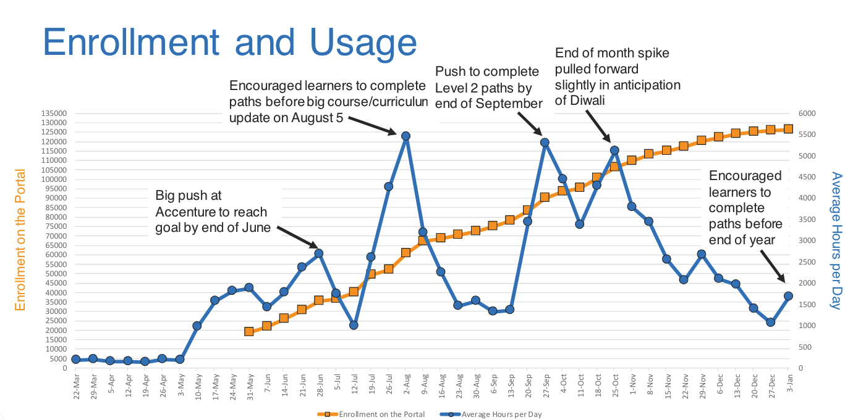
Goal Setting is Critical

Slide 26
Measure Competency For Thousands of Software Engineers
Wanted hands-on exercises in a competitive but fun way; primary driver set baseline for security competency
Deployed Blended Learning
CBT plus hands-on Cyber Range exercises
Measure Knowledge Gains and Retention
When combined with CBT, Cyber Range scores increased avg of 25%
Benchmark: Cyber Range scores 2,000+ for software engineers → no additional training
Feature Simulation, relevant to role and company culture
Hands-on cyber range events are challenging, fun, cool/trendy
Corporate executive always kicks-off/endorses program
Recurring Training (not point-in-time)
Blended learning program offered every month
Average score increase for second cyber range event was 71%

Slide 27
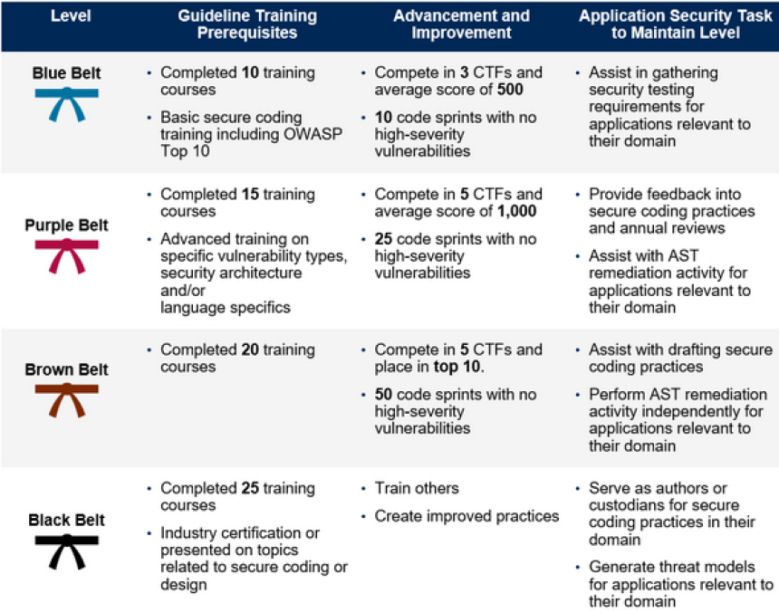
Gartner recommends “Belt” program*
Citrix had 80% participation in 2-year belt program
Combined belt program with financial compensation
Tied black belt status to promotion eligibility
*Report: “3 Steps to Integrate Security into DevOps” - 2020

Slide 28
Quick-start Steps
Assess (use NICE Workforce Development Framework) Stakeholders, roles, and technologies to create objectives
Pilot Few learners representing different audiences delineated by the assessment.
Prototype Use pilot results to tweak modules included within certain learning plans
Adjust Examine feedback on modules to further tweak paths and expand to other roles
Launch & Reinforce Use blended learning opportunities wherever possible
Notes:
Assessment: Assess the organization’s software security stakeholders—their roles and the
technologies they touch—to come up with training requirements/objectives. Either decide to use
presets determined by Security Innovation or tweak them based on the assessment results.
2. Pilot Program:
Start small with a pilot program of a few learners representing the different
learning audiences delineated by the assessment.
3. Rapid Prototyping:
Engage in rapid prototyping from the pilot results to tweak modules
included within certain learning plans; for example, the organization may find a product manager
needs to understand how embedded tech and IoT works so they may need to add two modules to
a plan that doesn’t currently include those.
4. Feedback Loop:
Once learning plans are rolled out across the organization, utilize learning
management tools to look at feedback on courses and trainee success to further tweak paths
5. Concept Reinforcement:
Reinforce training with blended learning opportunities. Security
Innovation’s Cyber Range offers one example of the kinds of real-world opportunities learners
should have to see how security concepts and vulnerabilities look in actual software.

Slide 29
Summary
Learning media should be mixed and tailored to specific roles
ILT, CBT, standards, reference guides
Use examples from your own environment if possible
Add Learning Milestones to make goals feel reachable
Short, focused modules to maintain attention span
Use incentives like belts, badges, and other recognition
Notes:
LEARNING & PRACTICING
As people personally experience the ‘how to’ of learning new skills, the better the questions they ask, and
the quicker the knowledge becomes a regular practice.
ADD LEARNING MILESTONES
Add Learning Milestones into your training and education program People are less motivated to learn and retain discrete topics and information if learning is treated as a “check box” activity. People want milestones in their training efforts that show progress and help them to gain recognition and demonstrate progress. As you prepare a learning curriculum for various team roles, build in a way to recognize people as they successfully advance through the courses and make sure everyone knows about it.
MAKE. YOUR PROGRAM COMPANY CULTURE RELEVANT
Find an icon or well-known symbol in your organization that resonates with employees; then incorporate it in your program or build your program around them.

Slide 30
Thank You
edadamsboston
@appsec
www.edtalks.io
eadams@securityinnovation.com

Slide 31
Steven Hernandez
Chief Information Security Officer
Director, Information Assurance Services
United States Department of Education
Kendra Parlock
Executive Director
Npower
Leo Sosa
Founder & CEO
Dev/Mission
Kiersten Todt
Managing Director
Liberty Group Ventures, LLC
Plenary Session: Career Discovery

Slide 32
Exhibit Hall
Break
3:00 p.m. – 3:30 p.m.
4:15 p.m. – 4:30 p.m.

Slide 33
3:30 p.m. – 4:15 p.m.
4:30 p.m. – 5:15 p.m.
Career Discovery
The Talent Lifecycle
The Learning Ecosystem
Effective Leadership
Breakout
Sessions

Slide 34
Evening Workshop
5 p.m. – 6:30 p.m.
Career and Counseling Professionals Workshop Series Kickoff: Exploring Cybersecurity Pathways and Tools
Visit the Networking Lounge in our virtual platform to register.

