Slide 1
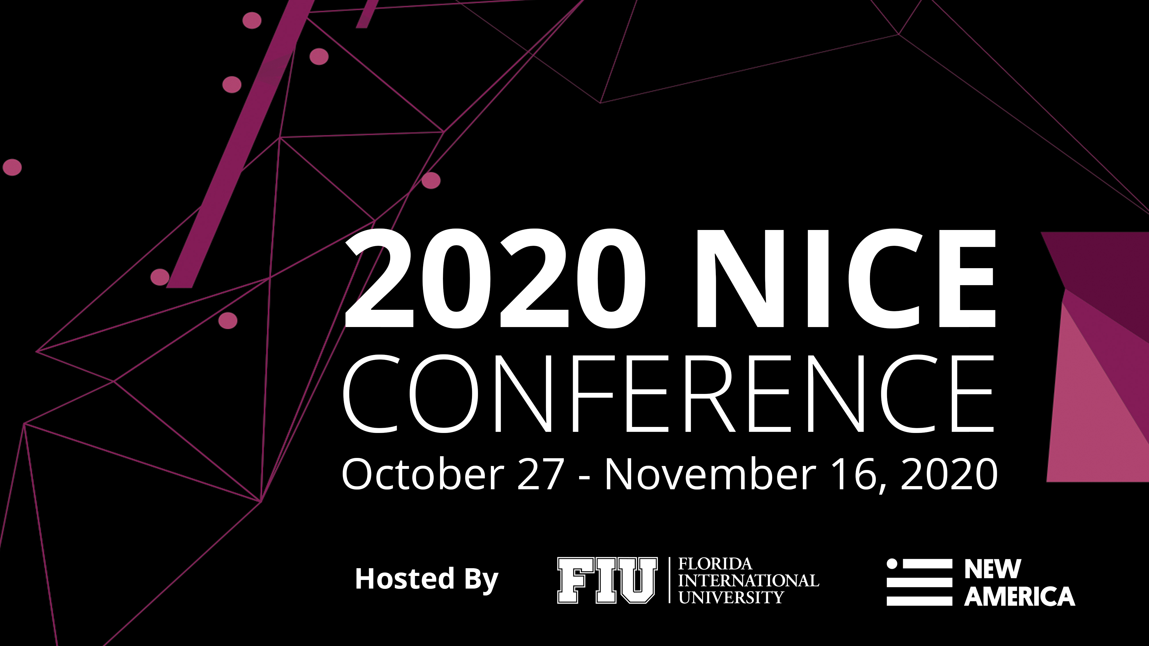

Slide 2
Randy Pestana
Director of Education and Training for Cybersecurity@FIU
Florida International University
Conference Emcee
Welcoming
Remarks

Slide 4
Brian Fonseca
Director, Jack D. Gordon Institute
Florida International University
Opening
Remarks

Slide 5
Nick Schacht
Chief Global Development Officer
Society for Human Resource Management
Peter Cappelli
Professor of Management at the Wharton School & Director of Wharton’s Center for HR
Wharton
Travis Hoadley
Director of Innovation, Cybersecurity Talent Management System
U.S. Department of Homeland Security
Deji Mabogunje
Director of Talent Acquisition
Akamai Technologies
Plenary Session: Modernizing the Talent Management Process

Slide 6
Introducing the Revised Workforce Framework for Cybersecurity (NICE Framework)
Karen Wetzel
Manager of the NICE Framework
National Initiative for Cybersecurity Education

Slide 7
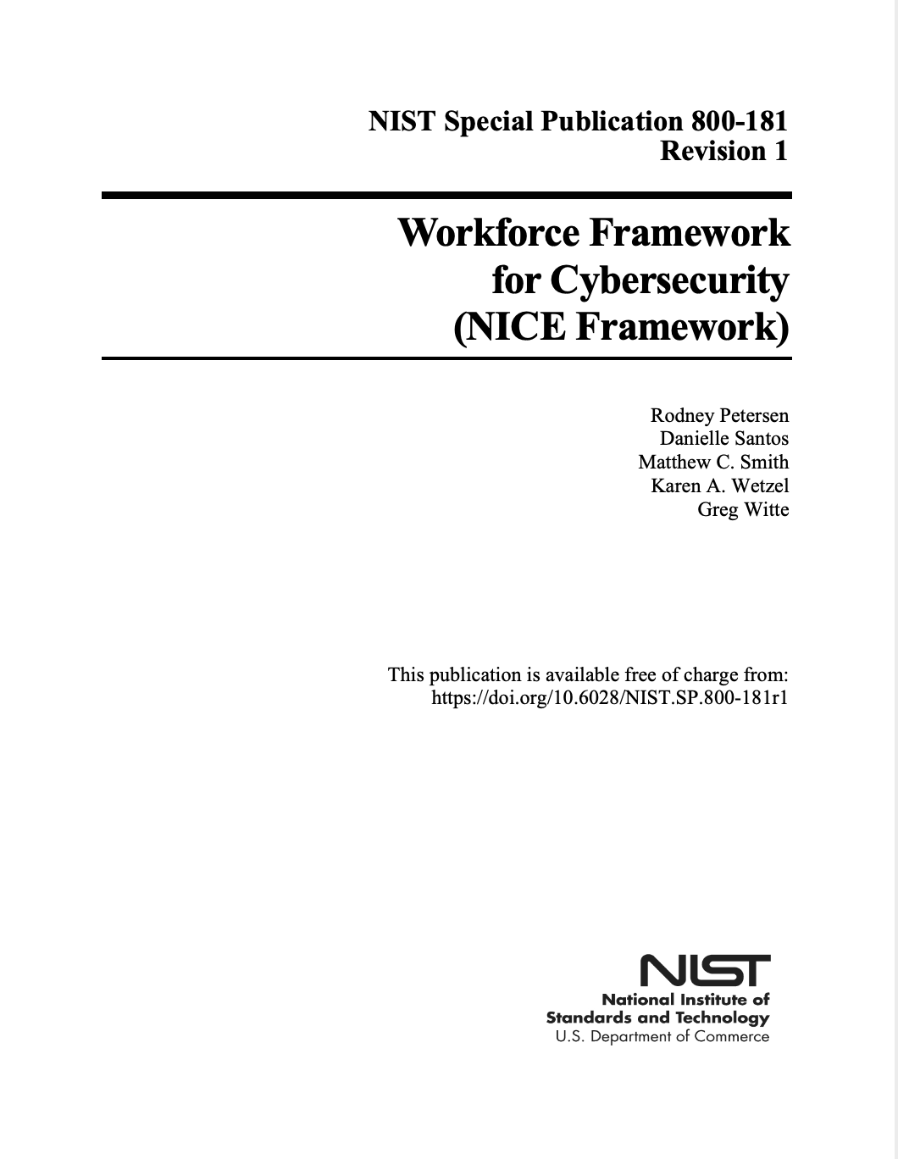
New! Revised NIST Special Publication 800-181
Title: Workforce Framework for Cybersecurity (NICE Framework)
Scope: Security of Cyberspace (Cybersecurity)
Focus: Cybersecurity Work
nist.gov/nice/framework
Notes:
“Cybersecurity Workforce” includes those whose primary focus is on cybersecurity as well as those in the workforce who need specific cybersecurity-related knowledge and skills in order to perform their work in a way that enables organizations to properly manage the cybersecurity-related risks to the enterprise.

Slide 8
Who is the Framework for?
EMPLOYERS
Public and Private Sectors
LEARNERS
Students
EDUCATION, TRAINING, AND CREDENTIAL PROVIDERS
Job-Seekers
Employees
Human Resources
Hiring Managers
Other SME’s
Learning Pathways
Credentials
Notes:
Blue office: https://commons.wikimedia.org/wiki/File:Kit_Out_My_Office%27s_%27HD_Colour%27_(blue_photo_2)_office_furniture.png
Learners: https://www.flickr.com/photos/unu-wider/44832221595
Class: https://www.pickpik.com/classroom-computers-education-class-education-technology-learning-155611

Slide 9
NICE Framework: Building Blocks
Tasks
Knowledge
Skills

Slide 10
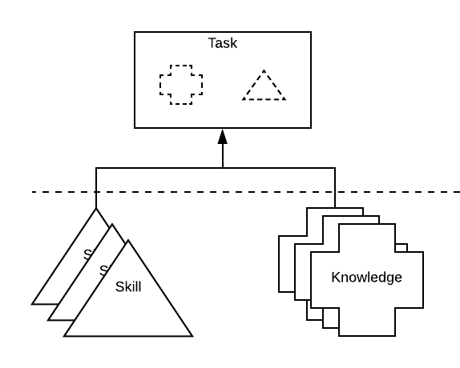
Tasks, Knowledge, and Skills (TKS)
Describes the Work
Describes the Learner

Slide 11
Applications and Uses
TEAMS
COMPETENCIES
WORK ROLES
Notes:
Hands: https://www.lifeofpix.com/photo/diverse-people-stacking-hands-together-3/
Tools:
Rob Kemme from Netherlands, CC BY-SA 2.0 <https://creativecommons.org/licenses/by-sa/2.0>, via Wikimedia Commons
https://commons.wikimedia.org/wiki/File:Old_tools_collection_(27204177988).jpg
Mountain: https://pixabay.com/photos/person-mountain-top-achieve-1245959/

Slide 12
NICE Webinar Series Announcement
Competencies: The Next Frontier for Closing the Cybersecurity Skills Gap
Wednesday, December 16, 2020
2-3 p.m. ET
Notes:
The recently revised Workforce Framework for Cybersecurity (NICE Framework) introduces Competencies as a mechanism for organizations to assess learners’ Knowledge and Skills and capability to perform Tasks. This webinar will describe a learner-centered approach to Competencies that is employer-driven and how assessments can be used to observe and measure learner capabilities.

Slide 13
NICE Framework Attributes
Agility
Flexibility
Interoperability
Modularity
Notes:
https://pxhere.com/en/photo/1459519
All that was shared above helps to make the framework….

Slide 14
December 2020 Launch of NICE Framework Users Group

Slide 15
Timeline for Review and Updates to NICE Framework
Webinar to Describe Process and Request for Comments
December 2019
Engagement with Key Stakeholders
Pre-November 2019
Adjudicate Comments Received
January-February 2020
First Draft of Changes for Comments
July 2020
Updates to Tasks, Knowledge, Skills, and Abilities , November 2019-2021
Announcement of Request for Comments November 2019
Request for Comments Deadline
January 2020
Consultative Process
March-May 2020
Final Draft of Changes
November 2020
Notes:
This is original timeline

Slide 16
2020-2021 Timeline
Announce Updates to TKS Statements, Competencies, and Work Roles November 2021
Request for Comments to NICE Framework Competencies January 2021
Revision Published & Launch of Users Group November – December 2020
TKS Statements and Work Role Review November 2020 – March 2021
NICE Framework Next Steps: November 2020-2021
Webinar to Describe Competencies
December 2020
Request for Comments to Change Process
February 2021
Community Workshops
March – September 2021
Notes:
This is original timeline

Slide 17
A Quick Recap!
NICE Framework Publication: Revised and now available! Streamlined document with core content:
Background
Explanation of Building Blocks
Description of Applications and Uses
NICE Framework Data: Tasks, Knowledge, Skills, and Work Roles (formerly appendices) now available at the NICE Framework Resource Center
NICE Framework Resource Center: Your one-stop-shop for NICE Framework content, tools, and additional educational resources

Slide 18
THANK YOU!
Karen Wetzel Manager of the NICE Framework
karen.wetzel@nist.gov
NICEFramework@nist.gov
NICE Framework Resource Center
nist.gov/nice/framework

Slide 19
Diane Janosek
Deputy Commandant for the National Cryptologic School
National Security Agency
Closing Remarks

Slide 20
National Centers of Academic Excellence in Cybersecurity
2020 Designation Ceremony

Slide 21
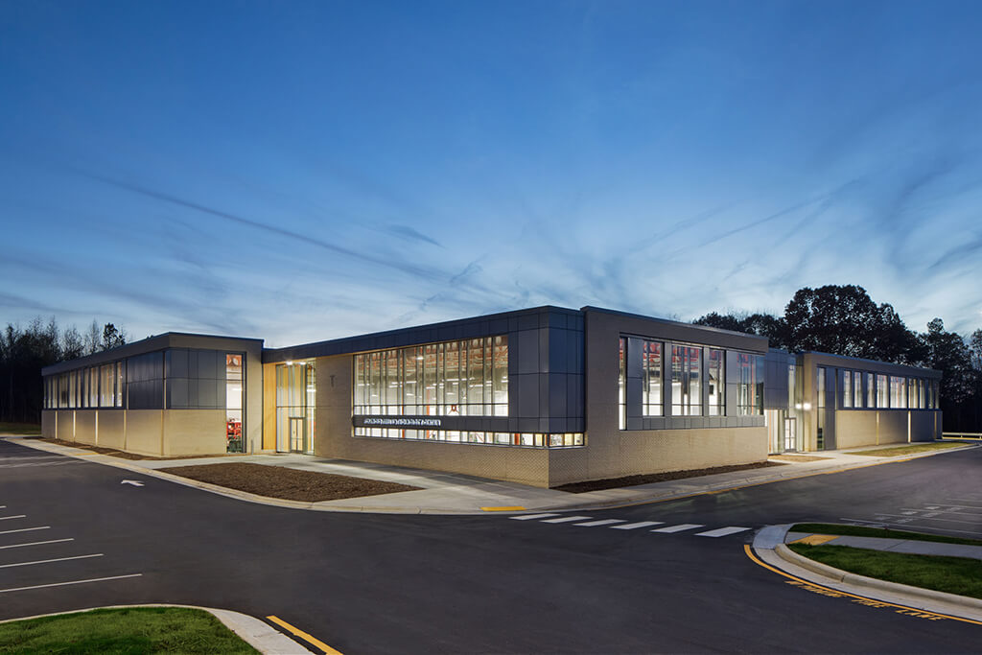
Alamance Community College
Graham, North Carolina
CAE-CD

Slide 22
Athens State University
Athens, Alabama
CAE-CD

Slide 23
Binghamton University (SUNY)
Binghamton, New York
CAE-R

Slide 24
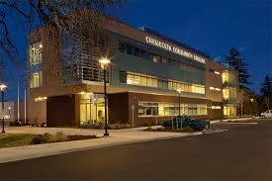
Chemeketa Community College
Salem, Oregon
CAE-CD

Slide 25
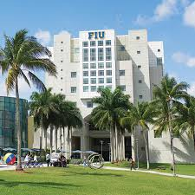
Florida International University
Miami, Florida
CAE-CD

Slide 26
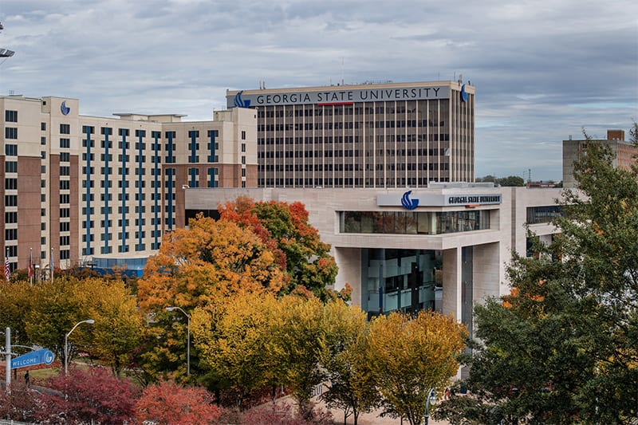
Georgia State University
Atlanta, Georgia
CAE-CD & CAE-R

Slide 27
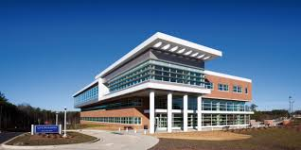
Gwinnett Technical College
Lawrenceville, Georgia
CAE-CD

Slide 28
Loyola University Chicago
Chicago, Illinois
CAE-CD

Slide 29
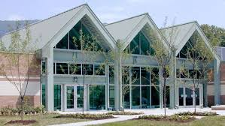
Mountain Empire Community College
Big Stone Gap, Virginia
CAE-CD

Slide 30
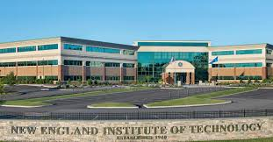
New England Institute of Technology
East Greenwich, Rhode Island
CAE-CD

Slide 31
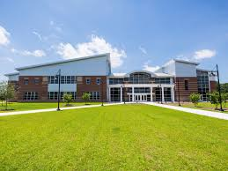
Pitt Community College
Winterville, North Carolina
CAE-CD

Slide 32
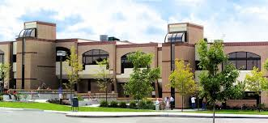
Pittsburgh Technical College
Oakdale, Pennsylvania
CAE-CD

Slide 33
Portland State University
Portland, Oregon
CAE-R

Slide 34
Purdue University Global
Indianapolis, Indiana
CAE-CD

Slide 35
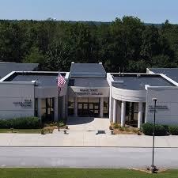
Roane State Community College
Harriman, Tennessee
CAE-CD

Slide 36
Saint Vincent College
Latrobe, Pennsylvania
CAE-CD

Slide 37
Sam Houston State University
Huntsville, Texas
CAE-CD

Slide 38
Tiffin University
Tiffin, Ohio
CAE-CD

Slide 39
University of Nevada, Reno
Reno, Nevada
CAE-CD

Slide 40
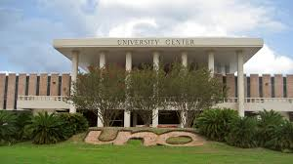
University of New Orleans
New Orleans, Louisiana
CAE-R

Slide 41
Virginia Commonwealth University
Richmond, Virginia
CAE-R

Slide 42
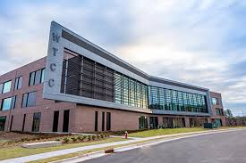
Wake Technical Community College
Raleigh, North Carolina
CAE-CD

Slide 43
Washtenaw Community College
Ann Arbor, Michigan
CAE-CD

Slide 44
Wright State University
Dayton, Ohio
CAE-CD

Slide 45
University of Massachusetts Dartmouth
Dartmouth, Massachusetts
CAE-R

Slide 46
United States Naval Academy
Annapolis, Maryland
CAE-CO

Slide 47
NCAE Regions – as of November 2020
335 NCAE Institutions
AK
WA -8
ME – 2
MT - 2
VT - 2
ND - 2
MN - 6
NH - 2
OR
2
OR - 4
WI - 4
MA - 5
ID - 3
NY - 15
RI - 3
SD - 1
MI - 13
CT - 2
WY
PA - 14
IA - 1
NJ - 7
NE - 4
OH - 11
DE - 2
NV - 3
IL - 13
IN –
6
UT - 2
WV –
3
VA - 22
CA - 14
CO - 11
KS - 6
KY- 2
MO - 7
KY - 6
NC - 12
OK - 4
TN - 6
HI - 5
AZ - 7
NM - 4
AR - 2
SC - 5
MS -1
AL - 10
GA - 11
TX - 22
LA- 3
FL –
18
PR - 1
Notes:
.

Slide 48
National Centers of Academic Excellence in
Cybersecurity
CONGRATULATIONS!
2020 Designation Ceremony

Slide 49
Exhibit Hall
Break
2:30 p.m. – 3:00 p.m.
3:45 p.m. – 4:00 p.m.

Slide 50
3:00 p.m. – 3:45 p.m.
4:00 p.m. – 4:45 p.m.
Career Discovery
The Talent Lifecycle
The Learning Ecosystem
Effective Leadership
Breakout
Sessions

Slide 51
Conference
Recordings
Conference recordings will be available on 11-23-2020 at niceconference.org

Slide 52
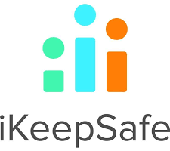
December 7-8, 2020
*register by December 4th
Track 1: Increasing Cybersecurity Career Awareness
Track 2: Infusing Cybersecurity Across the Education Portfolio (Sponsored by IBM)
Track 3: Integrating Innovative Cybersecurity Educational Approaches (Sponsored by Cyber.org)
Track 4: Designing Cybersecurity Academic and Career Pathways
Track 5: Promoting Cyber Awareness
Student Track: By Invitation Only (Sponsored by GBSI)
Sponsored By:
Hosted By:
Supported By:

